Slide 1
Interacting with Your Data Model
ENTITY FRAMEWORK CORE - Draft

Slide 2
Overview
Query
Basic Query
Conditional Query
Complex Query
Create/Saving Data
Changes Tracking
Update Date
Delete Date
Batch Operation
Asynchronous Operation

Slide 3
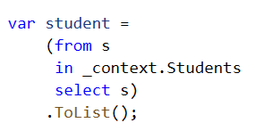
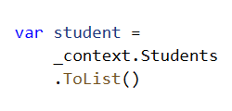
Basic Query
LINQ Methods
LINQ Statements
Equivalent to: SQL(“SELECT * FROM students;”)
Notes:
We have 2 ways to query ef core, by linq methods or statements, both methods will generate the same sql statement in the background.

Slide 4
LINQ: Language Integrated Query
ADDTIONAL
LINQ
Collections
Entity Framework
XML
SQL
LINQ is a .NET Framework component that adds native data querying capabilities to .NET languages.
Developer will be able to query different types of data sources by learning single query interface, LINQ.

Slide 5
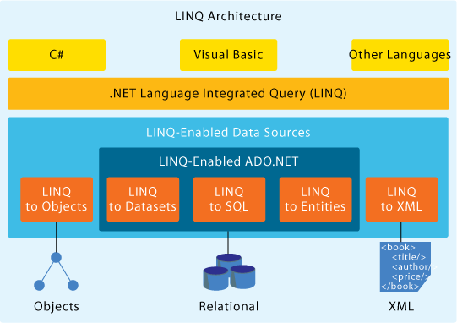
LINQ: Language Integrated Query
ADDTIONAL

Slide 6
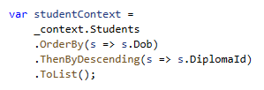

Conditional Query
Where
Order By
ASC Default
Equivalent to: SQL(“
SELECT * FROM students WHERE AdminNo = N'193265K‘; ”)
Equivalent to: SQL(“
SELECT * FROM students ORDER BY Dob, DiplomaId DESC; ”)

Slide 7
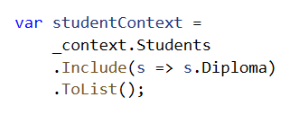
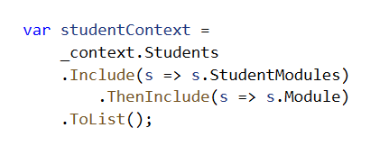
Complex Query
SIMPLE JOIN
ADVANCE JOIN
Equivalent to: SQL(“
SELECT * FROM students s INNER JOIN Diploma d ON s.DiplomaId = d.DiplomaId; ”)
Equivalent to: SQL(“
… INNER JOIN ( SELECT AdminNo FROM Students AS) AS t ON s.StudentModules.AdminNo = t.AdminNo; ”)

Slide 8


Aggregated Query
COUNT
MAX
Equivalent to: SQL(“
SELECT COUNT(*) FROM students;” )
Equivalent to: SQL(“
SELECT MAX(Dob) FROM students;” )

Slide 9
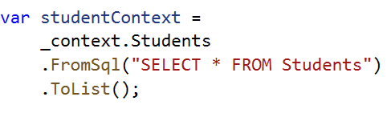
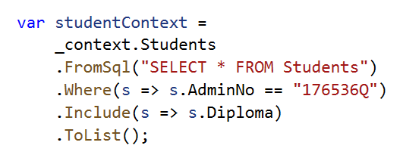
Raw Query
ADDTIONAL
If you prefer SQL…
You can do this too:

Slide 10
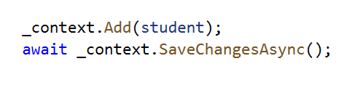
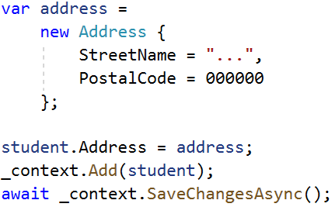
Create/Save Data
Saving Data is easy
Save Related Data Using Reference Navigational Properties
Assign Reference

Slide 11

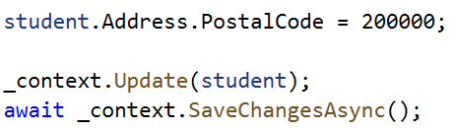
Update Data
Update single entity
Update Related Data Using Reference Navigational Properties

Slide 12

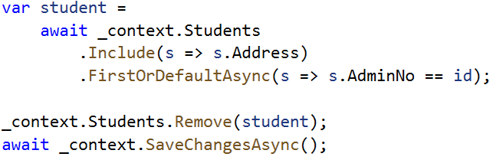
Delete Data
Delete Entity
Delete Related Data
Remove Relationship
Depending
on your
Configuration
Related Data Foreign Key set to Null
Cascade Delete
Related Date Deleted
Notes:
Configuration here refers to the config for database context relationship mapping configs, for more read relation mapping

Slide 13
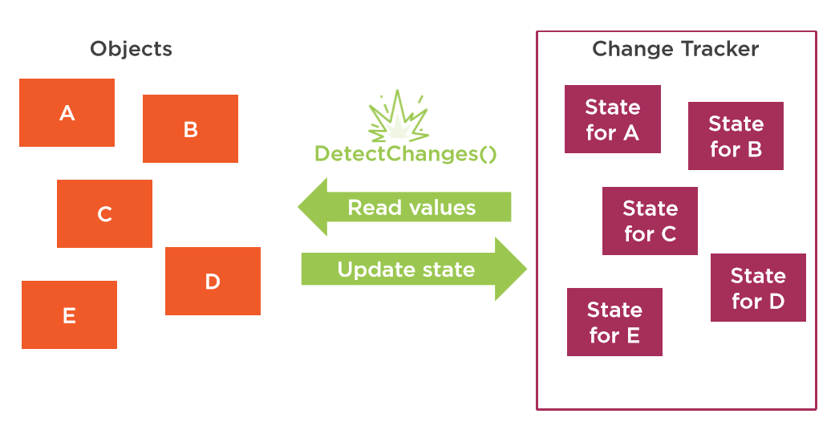
How does SaveChanges() work?
Change Tracker track the state of your objects.
Added
Modified
Removed
Database context has change tracker
Context will know what data to change
Notes:
It you work with a lot of different entities and related data, it will be very difficult for us to keep track of the changes manually, with this, context will handle all tracking automatically. We only need to call save changes method and all changes will be processed by context.

Slide 14
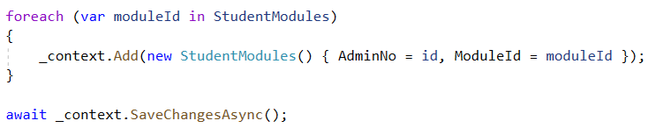
Batch Operation
Batch operation is simply performing multiple database operation in a single SQL execution call
Although object is added to database context, no actual data is written to database yet
This is the actual point of execution
There will only be one database call to insert all the data, thus more efficient.

Slide 15

Asynchronous Operation
Equivalent async method
Asynchronous queries avoid blocking a thread while the query is executed in the database.
ToList()
First()
FirstOrDefault()
Single()
SingleOrDefault()
Last()
LastOrDefault()
Count()
Min()
Max()
Average()
ToListAsync()
FirstAsync()
FirstOrDefaultAsync()
SingleAsync()
SingleOrDefaultAsync()
LastAsync()
LastOrDefaultAsync()
CountAsync()
MinAsync()
MaxAsync()
AverageAsync()
E.g. You do not want to freeze your windows when waiting for database to response

